Slide 1
VM & VE & VG 450
The Engineering Design Process
Copyright 2018. All Rights Reserved
Notes:
VM467 - Introduction to Robotics UM-SJTU Joint Institute, Shanghai Jiao Tong University Copyright 2009. Kai Xu. All Rights Reserved

Slide 2
Outline
The Engineering Design Process
The IDEO Video and the Discussion on Creativity.
Notes:
VM467 - Introduction to Robotics UM-SJTU Joint Institute, Shanghai Jiao Tong University Copyright 2009. Kai Xu. All Rights Reserved

Slide 3
The Four C’s of Design
Creativity
  Requires creation of something that has not existed before or has not existed in the designer’s mind before.
Complexity
  Requires decisions on many variables and parameters.
Choice
  Requires making choices among many possible solutions at all levels, from basic concepts to the smallest detail of shape.
Comprise
  Requires balancing multiple and conflicting requirements.
Notes:
VM467 - Introduction to Robotics UM-SJTU Joint Institute, Shanghai Jiao Tong University Copyright 2009. Kai Xu. All Rights Reserved

Slide 4
The Importance of Design
Decisions made in the design process cost very little, but have a major effect on the cost of the product.
  Only 5% of the total cost to produce a product is consumed in the design process versus 95% in the manufacturing process.
  Decisions made in the design process affect 70~80% of the product cost, while decisions made beyond the design phase can influence only 20~30% of the product cost.
Manufacturing cannot compensate for defects in design.
The goal of design is to develop quality, cost-competitive products in the shortest time possible.
Notes:
VM467 - Introduction to Robotics UM-SJTU Joint Institute, Shanghai Jiao Tong University Copyright 2009. Kai Xu. All Rights Reserved

Slide 5
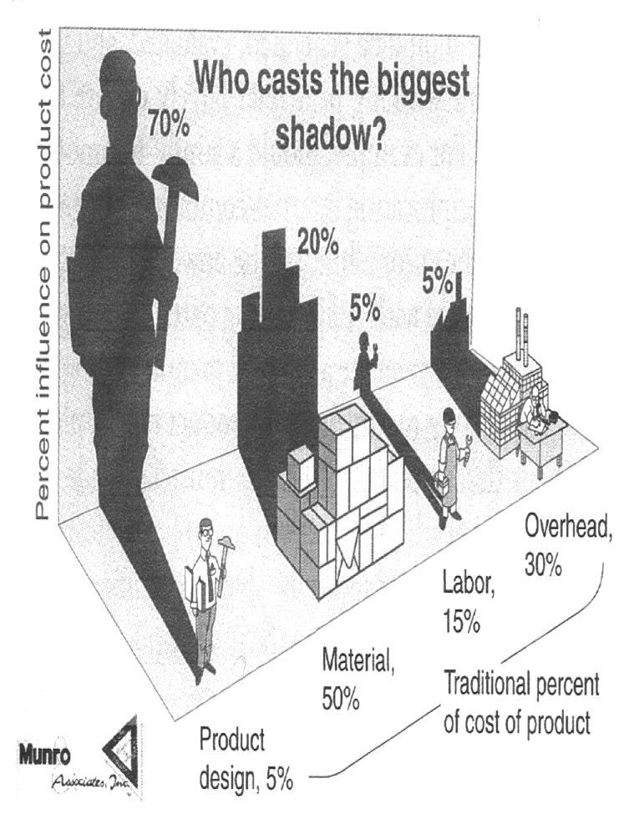
Influence of Design Process
Most of the problems with new products are the result of poor design procedures.
Notes:
VM467 - Introduction to Robotics UM-SJTU Joint Institute, Shanghai Jiao Tong University Copyright 2009. Kai Xu. All Rights Reserved

Slide 6
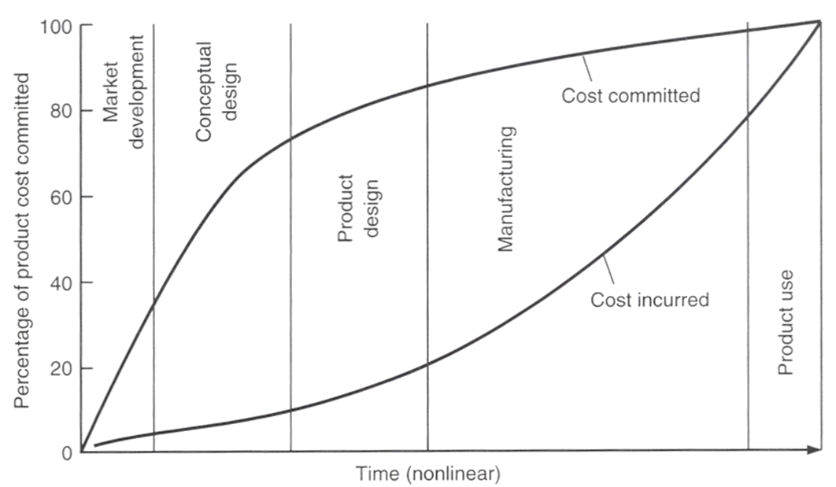
Product Cost Commitment
Notes:
VM467 - Introduction to Robotics UM-SJTU Joint Institute, Shanghai Jiao Tong University Copyright 2009. Kai Xu. All Rights Reserved

Slide 7
Types of Design
Original design or innovative design
Adaptive design
Redesign
Selection design
Industrial design
Notes:
VM467 - Introduction to Robotics UM-SJTU Joint Institute, Shanghai Jiao Tong University Copyright 2009. Kai Xu. All Rights Reserved

Slide 8
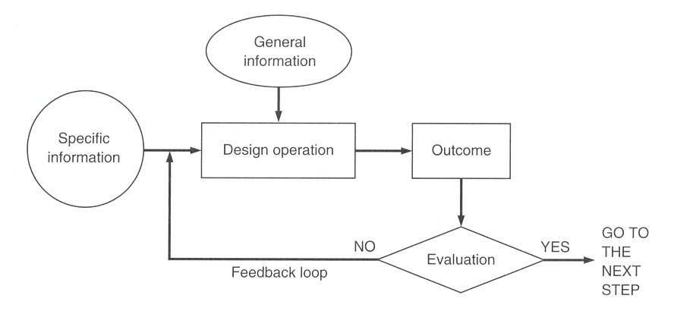
A Simplified Model of the Design Process
Notes:
VM467 - Introduction to Robotics UM-SJTU Joint Institute, Shanghai Jiao Tong University Copyright 2009. Kai Xu. All Rights Reserved

Slide 9
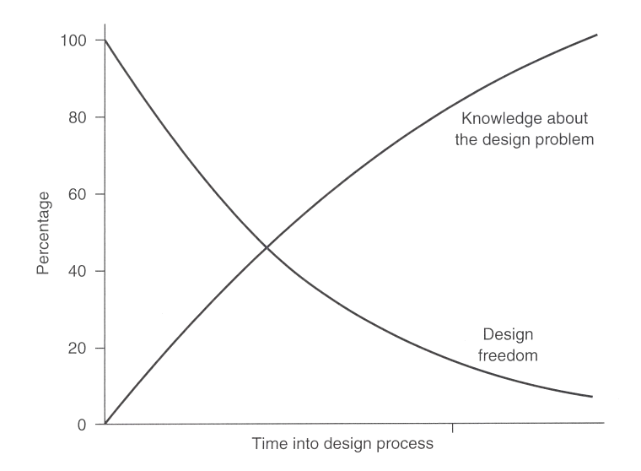
The Design Paradox
Notes:
VM467 - Introduction to Robotics UM-SJTU Joint Institute, Shanghai Jiao Tong University Copyright 2009. Kai Xu. All Rights Reserved

Slide 10
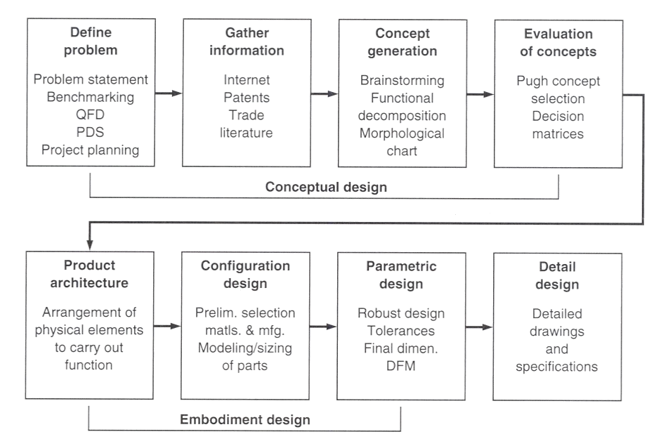
Concept, Embodiment and Detail Design
Notes:
VM467 - Introduction to Robotics UM-SJTU Joint Institute, Shanghai Jiao Tong University Copyright 2009. Kai Xu. All Rights Reserved

Slide 11
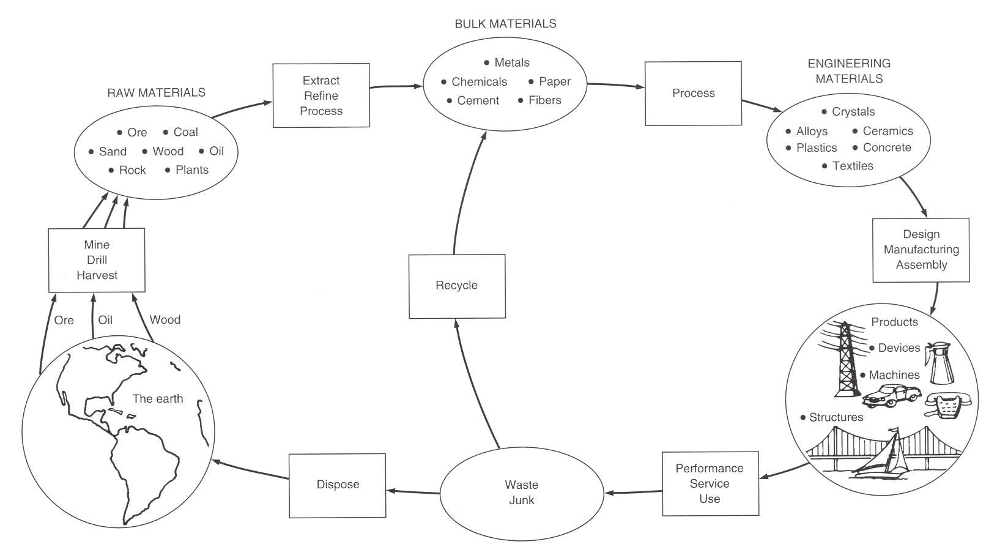
The Total Life Cycle
Notes:
VM467 - Introduction to Robotics UM-SJTU Joint Institute, Shanghai Jiao Tong University Copyright 2009. Kai Xu. All Rights Reserved

Slide 12
A Production Process
Phase I. Conceptual Design
Phase II. Embodiment Design
Phase III. Detail Design
Phase IV. Planning for Manufacture
Phase V. Planning for Distribution
Phase VI. Planning for Use
Phase VII. Planning for Retirement of the Product
Notes:
VM467 - Introduction to Robotics UM-SJTU Joint Institute, Shanghai Jiao Tong University Copyright 2009. Kai Xu. All Rights Reserved

Slide 13
Environmental Responsibility
Easy to disassemble
Able to be recycled
Contains recycled materials
Uses identifiable and recyclable plastics
Reduces use of energy and natural materials in its manufacture
Manufactured without producing hazardous waste
Avoids use of hazardous materials
Reduces product chemical emissions
Reduces product energy consumption
Notes:
VM467 - Introduction to Robotics UM-SJTU Joint Institute, Shanghai Jiao Tong University Copyright 2009. Kai Xu. All Rights Reserved

Slide 14

IDEO
Notes:
VM467 - Introduction to Robotics UM-SJTU Joint Institute, Shanghai Jiao Tong University Copyright 2009. Kai Xu. All Rights Reserved

Slide 15
What Did You Learn in IDEO
They are good at the process of design and innovation
Survey and benchmark of shopping cart
  Very complete and detail
Deep Dive – IDEO’s unique brain-storming method, total immersion in the problem and concept generation
  One conversation at a time
  Stay focused
  Encourage WILD ideas
  Defer judgment (buzz if you start to criticize others’ ideas)
  Build on the ideas of others (no not-invented-here or not-invented-by-me mentality)
Notes:
VM467 - Introduction to Robotics UM-SJTU Joint Institute, Shanghai Jiao Tong University Copyright 2009. Kai Xu. All Rights Reserved

Slide 16
What Did You Learn in IDEO
It is a “Focused Chaos”
Enlightened trial-and-error succeeds over the planning
of the lone genius (leadership behind the innovation process)
Fail often in order to succeed sooner
No ranking, hierarchy in discussion
Re-focus the deep dive periodically (led by leaders)
Voting for the best ideas
  You can only have one idea at the Expo
Notes:
VM467 - Introduction to Robotics UM-SJTU Joint Institute, Shanghai Jiao Tong University Copyright 2009. Kai Xu. All Rights Reserved

Slide 17
Think
Wildly, differently, creatively
Notes:
VM467 - Introduction to Robotics UM-SJTU Joint Institute, Shanghai Jiao Tong University Copyright 2009. Kai Xu. All Rights Reserved

Slide 18
Greatest Engineering
Achievements of the 20th Century
Electrification
Automobile
Airplane
Water Supply and Distribution
Electronics
Radio and Television
Agricultural Mechanization
Computers
Telephone
Air Conditioning and Refrigeration, etc.
VM450 & VE450 UM-SJTU Joint Institute, Shanghai Jiao Tong University Copyright 2017. All Rights Reserved
Notes:
VM467 - Introduction to Robotics UM-SJTU Joint Institute, Shanghai Jiao Tong University Copyright 2009. Kai Xu. All Rights Reserved

Slide 19

The Hidden Secrets of the Creative Mind
What is creativity? Where does it come from?
The workings of the creative mind have been subjected to intense research in psychology, sociology, anthropology and neuroscience.
Innovation requires no special thought processes; Creative people just work harder at it.
Keith Sawyer (Washington University Psychologist) Explaining Creativity: The Science of Human Innovation (Oxford; 336 pages) 2006.
VM450 & VE450 UM-SJTU Joint Institute, Shanghai Jiao Tong University Copyright 2017. All Rights Reserved
Notes:
VM467 - Introduction to Robotics UM-SJTU Joint Institute, Shanghai Jiao Tong University Copyright 2009. Kai Xu. All Rights Reserved

Slide 20
The Hidden Secrets of the Creative Mind
Q1. Has the new wave of research upended any of our popular notions about creativity?
  Ans. Virtually all of them. Many people believe creativity comes in a sudden moment of insight and that this "magical" burst of an idea is a different mental process from our everyday thinking.
  But extensive research has shown that when you're creative, your brain is using the same mental building blocks you use every day!
VM450 & VE450 UM-SJTU Joint Institute, Shanghai Jiao Tong University Copyright 2017. All Rights Reserved
Notes:
VM467 - Introduction to Robotics UM-SJTU Joint Institute, Shanghai Jiao Tong University Copyright 2009. Kai Xu. All Rights Reserved

Slide 21
The Hidden Secrets of the Creative Mind
Q2. Then how do you explain the "aha!" moment we've all had in the shower or the gym—or anywhere but at work?
  Ans. In creativity research, we refer to the three Bs—for the bathtub, bed and bus —places where ideas have famously and suddenly emerged.
  When we take time off from working on a problem, we change what we're doing, and that can activate different areas of our brain.
  If the answer wasn't in the part of the brain we were using, it might be in another. If we're lucky, in the next context we may hear or see something that relates — distantly — to the problem that we had temporarily put aside.
VM450 & VE450 UM-SJTU Joint Institute, Shanghai Jiao Tong University Copyright 2017. All Rights Reserved
Notes:
VM467 - Introduction to Robotics UM-SJTU Joint Institute, Shanghai Jiao Tong University Copyright 2009. Kai Xu. All Rights Reserved

Slide 22
The Hidden Secrets of the Creative Mind
Q3. What has been learned from historical research?
  Ans. Studying notebooks, manuscripts and historical records, we've dissected the creative process of people like the Wright brothers, Charles Darwin, T.S. Eliot, Jackson Pollock, even business innovators like Citigroup's John Reed.
  We find that creativity happens not with one brilliant flash but in a chain reaction of many tiny sparks while executing an idea.
VM450 & VE450 UM-SJTU Joint Institute, Shanghai Jiao Tong University Copyright 2017. All Rights Reserved
Notes:
VM467 - Introduction to Robotics UM-SJTU Joint Institute, Shanghai Jiao Tong University Copyright 2009. Kai Xu. All Rights Reserved

Slide 23
The Hidden Secrets of the Creative Mind
Q4. Are there other generalizations you can make about creative people?
  Ans. Yes. They have tons of ideas, many of them bad. (Note: Remember IDEO!) The trick is to evaluate them and mercilessly purge the bad ones. But even bad ideas can be useful.
  Darwin's notebooks, for example, show us that he went down many dead ends. Darwin spent years refining this bizarre theory before ultimately rejecting it. But it was a critical link in the chain that led to his branching model of evolution.
VM450 & VE450 UM-SJTU Joint Institute, Shanghai Jiao Tong University Copyright 2017. All Rights Reserved
Notes:
VM467 - Introduction to Robotics UM-SJTU Joint Institute, Shanghai Jiao Tong University Copyright 2009. Kai Xu. All Rights Reserved

Slide 24
The Hidden Secrets of the Creative Mind
Q5. So how can the average person get more ideas?
  Ans. Here's where we come up against another of our cultural myths about creativity — that of the lone genius.
  Ideas don't magically appear in a genius' head from nowhere. They always build on what came before.
  Collaboration is key. Brainstorm with people in different fields.
  Research and anecdotal evidence suggest that distant analogies lead to new ideas — like when a heart surgeon bounces things off an architect or a graphic designer.
VM450 & VE450 UM-SJTU Joint Institute, Shanghai Jiao Tong University Copyright 2017. All Rights Reserved
Notes:
VM467 - Introduction to Robotics UM-SJTU Joint Institute, Shanghai Jiao Tong University Copyright 2009. Kai Xu. All Rights Reserved

Slide 25
The Hidden Secrets of the Creative Mind
Q6. What advice can you give us nongeniuses to help us be more creative?
  Take risks, and expect to make lots of mistakes, because creativity is a numbers game.
  Work hard, take some breaks, but stay with it over time.
  Do what you love, because creative breakthroughs take years of hard work.
  Develop a network of colleagues and schedule time for freewheeling, unstructured discussions.
  Most of all, forget those romantic myths that creativity is all about being gifted and not about hard work. They discourage us because we're waiting for that one full-blown moment of inspiration.
VM450 & VE450 UM-SJTU Joint Institute, Shanghai Jiao Tong University Copyright 2017. All Rights Reserved
Notes:
VM467 - Introduction to Robotics UM-SJTU Joint Institute, Shanghai Jiao Tong University Copyright 2009. Kai Xu. All Rights Reserved

Slide 26
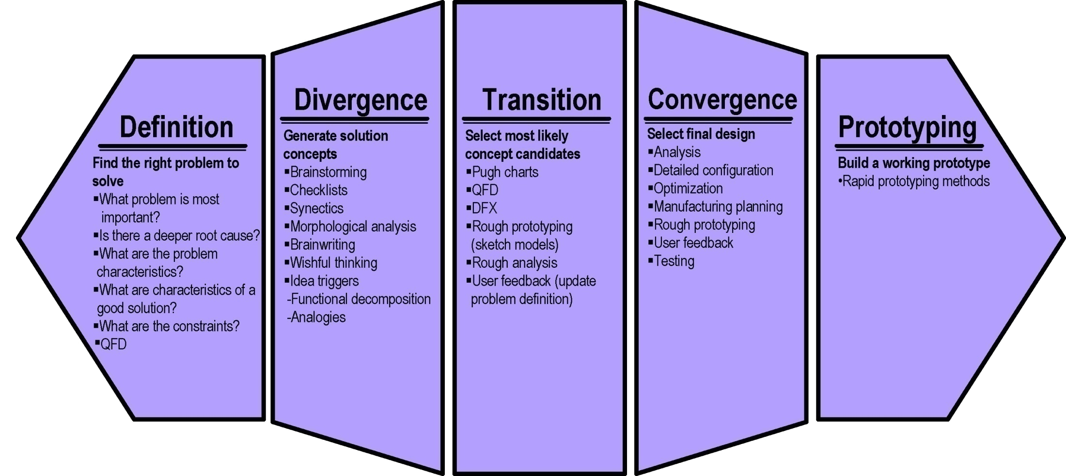
VM450 & VE450 Design Process
Multiple iterations
VM450 & VE450 UM-SJTU Joint Institute, Shanghai Jiao Tong University Copyright 2017. All Rights Reserved
Notes:
VM467 - Introduction to Robotics UM-SJTU Joint Institute, Shanghai Jiao Tong University Copyright 2009. Kai Xu. All Rights Reserved

